Slide 1

Performance accessment based on behavior Pattern
Xi Zhang
Presented by Crystal
University of Science and Technolgy of China

Slide 2

Students with poor performance
Behavior in daily life

Slide 3

Backgroud
University of China
Small social system
Opprtunity
Information-based education
Rich data
Basic Information
Course Performance
Tracing record
Identity authentication

Slide 4
Backgroud
Academic performance
the key inficators to evalutate educational level
Discovering students with poor performance
Effective supervision
Developing good study habits

Slide 5
Objective
Given: smart card records
Given: students' performance labels
Goal:
Build behavior pattern and extract features
Discover students with poor performance
Mine the relevance between behaviors and performance

Slide 6
Framework
B
Smart Card Reconds
Behavior Sequences
Hidden Markow Model
Performance
Behavior Pattern Building
Statistic Features
Relevant Features
Multitask Model
Behavior Feature Extration
0
0
...
1
1
0
...
0
0
1
...
0

Slide 7
Solution
1
Building behavior pattern
Event
UID | DEALTIME | MONEY | ORGINID | DEALCODE
U1 | 2015-03-02 09:29:39 | 400 | 1 | 04
U1 | 2015-03-02 09:47:31 | 2.8 | 1020002002 | 20
U1 | 2015-03-02 11:56:03 | 2.5 | 1020002 | 20
U1 | 2015-03-02 11:56:23 | 5 | 1020002 | 20
U1 | 2015-03-02 17:34:46 | 2 | 1049 | 20
... | ... | ... | ... | ...
Activity
Activity
Sequences
Behavior
Behavior Sequence

Slide 8
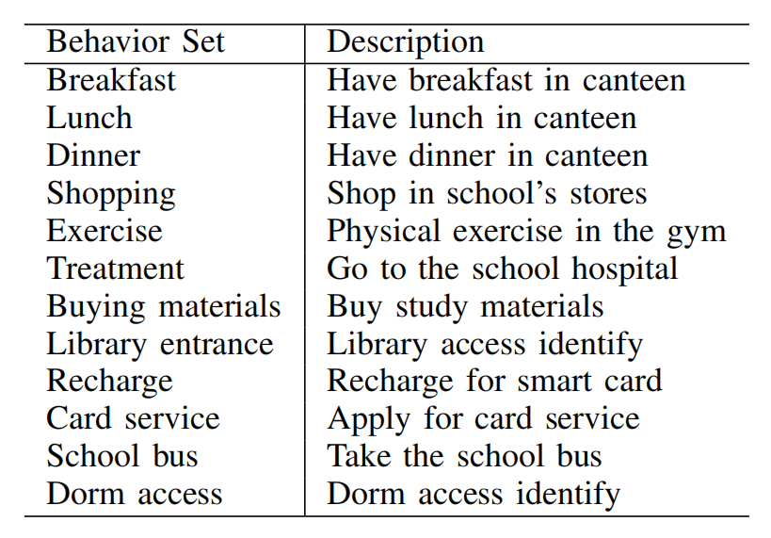
Solution
2.1
Behavior Features Extraction

Slide 9
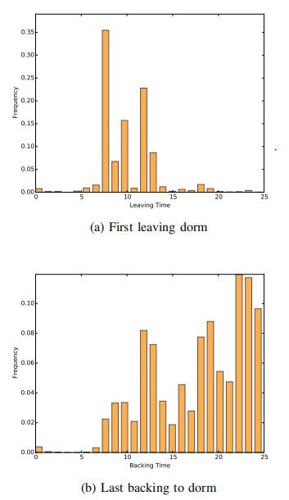
Solution
2.2
Statistics Features
Additional behaviors
Meal
Meal at weekends
Dorm access
Leaving before 8 a.m
Backing after 10 p.m

Slide 10
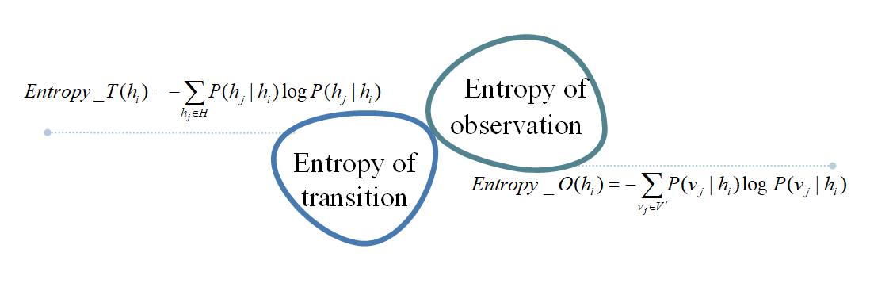
Solution
2.3
Relevance Features
Based on Markov Modeling

Slide 11
Solution
3.1
Poor Performance Discovery
Single-task approaches for performance discovery
Predicting performance on all courses as a whole
Training model for each course independently

Slide 12
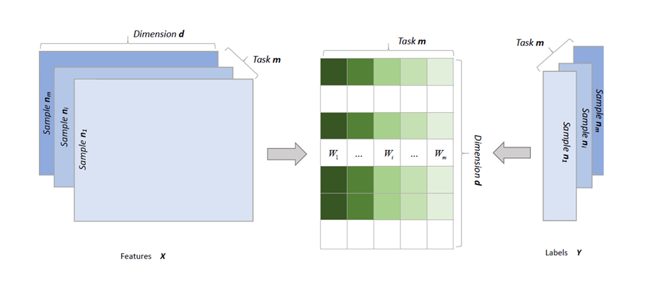
Solution
3.2
Poor Performance Discovery
Regularized Multi-task Modeling

Slide 13
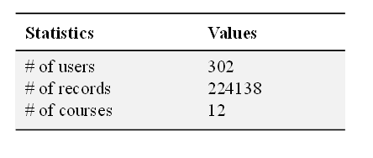
Experiments
Experiments data set
Imbalanced data preprocessing
SMOTE

Slide 14
Experiments
Selecting parameters
Five-flod cross validation based on grid search
Imbalanced data preprocessing
Accuracy
Precision
Recall
F1.Score
ROC&&AUC

Slide 15
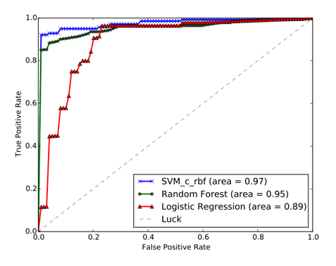
Experiments
Different single-task model
Logistic Regression
SVM with RBF kernel
Random Forests
Comparison result
Coarse-grained single-task models achieve a good outcome
Behavior features are effective to poor performance discovery

Slide 16
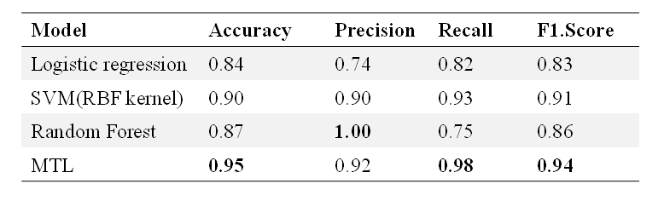
Experiments
Comparison between single task and multi-task models
Multi-task model shows good results, especially high recall

Slide 17
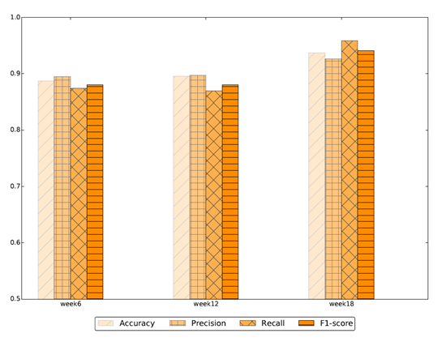
Experiments
Early warning
The metrics are high in the early stage of the semester

Slide 18
Conclusion
B
Smart Card Reconds
Behavior Sequences
Hidden Markow Model
Performance
Behavior Pattern Building
Statistic Features
Relevant Features
Multitask Model
Behavior Feature Extration
0
0
...
1
1
0
...
0
0
1
...
0
A general frameworl to discover poor performance

Slide 19
Conclusion
Build behavior pattern and extract features
Statistics features
Relevance features
Use a regularized multi-task model

Slide 20
蓝色简洁通用学术毕业答辩模板
Blue Concise General Academic Graduation Defense Template
单击添加论点
单击添加论点
单击添加论点
单击添加论点
单击添加论点内容单击添加论点内容单击添加论点内容单击添加论点内容单击添加论点内容
单击添加论点内容单击添加论点内容单击添加论点内容单击添加论点内容
单击添加论点内容单击添加论点内容单击添加论点内容单击添加论点内容单击添加论点内容
单击添加论点内容单击添加论点内容单击添加论点内容单击添加论点内容
单击添加论点内容单击添加论点内容单击添加论点内容单击添加论点内容单击添加论点内容
单击添加论点内容单击添加论点内容单击添加论点内容单击添加论点内容
单击添加论点内容单击添加论点内容单击添加论点内容单击添加论点内容单击添加论点内容
单击添加论点内容单击添加论点内容单击添加论点内容单击添加论点内容

Slide 21

第二部分
蓝色简洁通用学术毕业答辩模板
Blue Concise General Academic Graduation Defense Template

Slide 22
蓝色简洁通用学术毕业答辩模板
Blue Concise General Academic Graduation Defense Template
单击添加论点
单击添加论点
单击添加论点内容单击添加论点内容单击添加论点内容单击添加论点内容单击添加论点内容
单击添加论点内容单击添加论点内容单击添加论点内容单击添加论点内容
单击添加论点内容单击添加论点内容单击添加论点内容单击添加论点内容单击添加论点内容
单击添加论点内容单击添加论点内容单击添加论点内容单击添加论点内容
单击添加论点
单击添加论点内容单击添加论点内容单击添加论点内容单击添加论点内容单击添加论点内容
单击添加论点内容单击添加论点内容单击添加论点内容单击添加论点内容

Slide 23
第三部分
蓝色简洁通用学术毕业答辩模板
Blue Concise General Academic Graduation Defense Template

Slide 24
蓝色简洁通用学术毕业答辩模板
Blue Concise General Academic Graduation Defense Template
标题文本预设
标题文本预设
此部分内容作为文字排版占位显示
（建议使用主题字体）
此部分内容作为文字排版占位显示
（建议使用主题字体）
标题文本预设
标题文本预设
此部分内容作为文字排版占位显示
（建议使用主题字体）
此部分内容作为文字排版占位显示
（建议使用主题字体）
标题文本预设
标题文本预设
此部分内容作为文字排版占位显示
（建议使用主题字体）
此部分内容作为文字排版占位显示
（建议使用主题字体）

Slide 25
第四部分
蓝色简洁通用学术毕业答辩模板
Blue Concise General Academic Graduation Defense Template

Slide 26

蓝色简洁通用学术毕业答辩模板
Blue Concise General Academic Graduation Defense Template
单击添加论点
单击添加论点内容单击添加论点内容单击添加论点内容单击添加论点内容单击添加论点内容
单击添加论点内容单击添加论点内容单击添加论点内容单击添加论点内容

Slide 27
第五部分
蓝色简洁通用学术毕业答辩模板
Blue Concise General Academic Graduation Defense Template

Slide 28
蓝色简洁通用学术毕业答辩模板
Blue Concise General Academic Graduation Defense Template
标题文本预设
此部分内容作为文字排版占位显示
（建议使用主题字体）
关键词
标题文本预设
关键词
此部分内容作为文字排版占位显示
（建议使用主题字体）
标题文本预设
此部分内容作为文字排版占位显示
（建议使用主题字体）
关键词
关键词
标题文本预设
此部分内容作为文字排版占位显示
（建议使用主题字体）

Slide 29
谢谢
请各位老师批评指正！
Blue Concise General Academic Graduation Defense Template

Slide 30
Notes:
使用说明：选中图片；删除原图片，点击图标替换为自己的图片，置于底层。©SAYOU DESIGN版权所有，盗版必究

Slide 31






更多作品

Slide 32

SAY YOUR POINT.
说出你的演示
更多作品：http://chn.docer.com/works?userid=209609904

